Slide 1
k-Nearest Neighbors
Does [0] compute?
Li Lei
09/09/2026

Slide 2
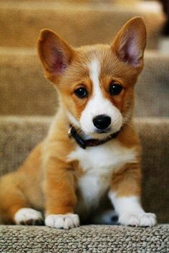
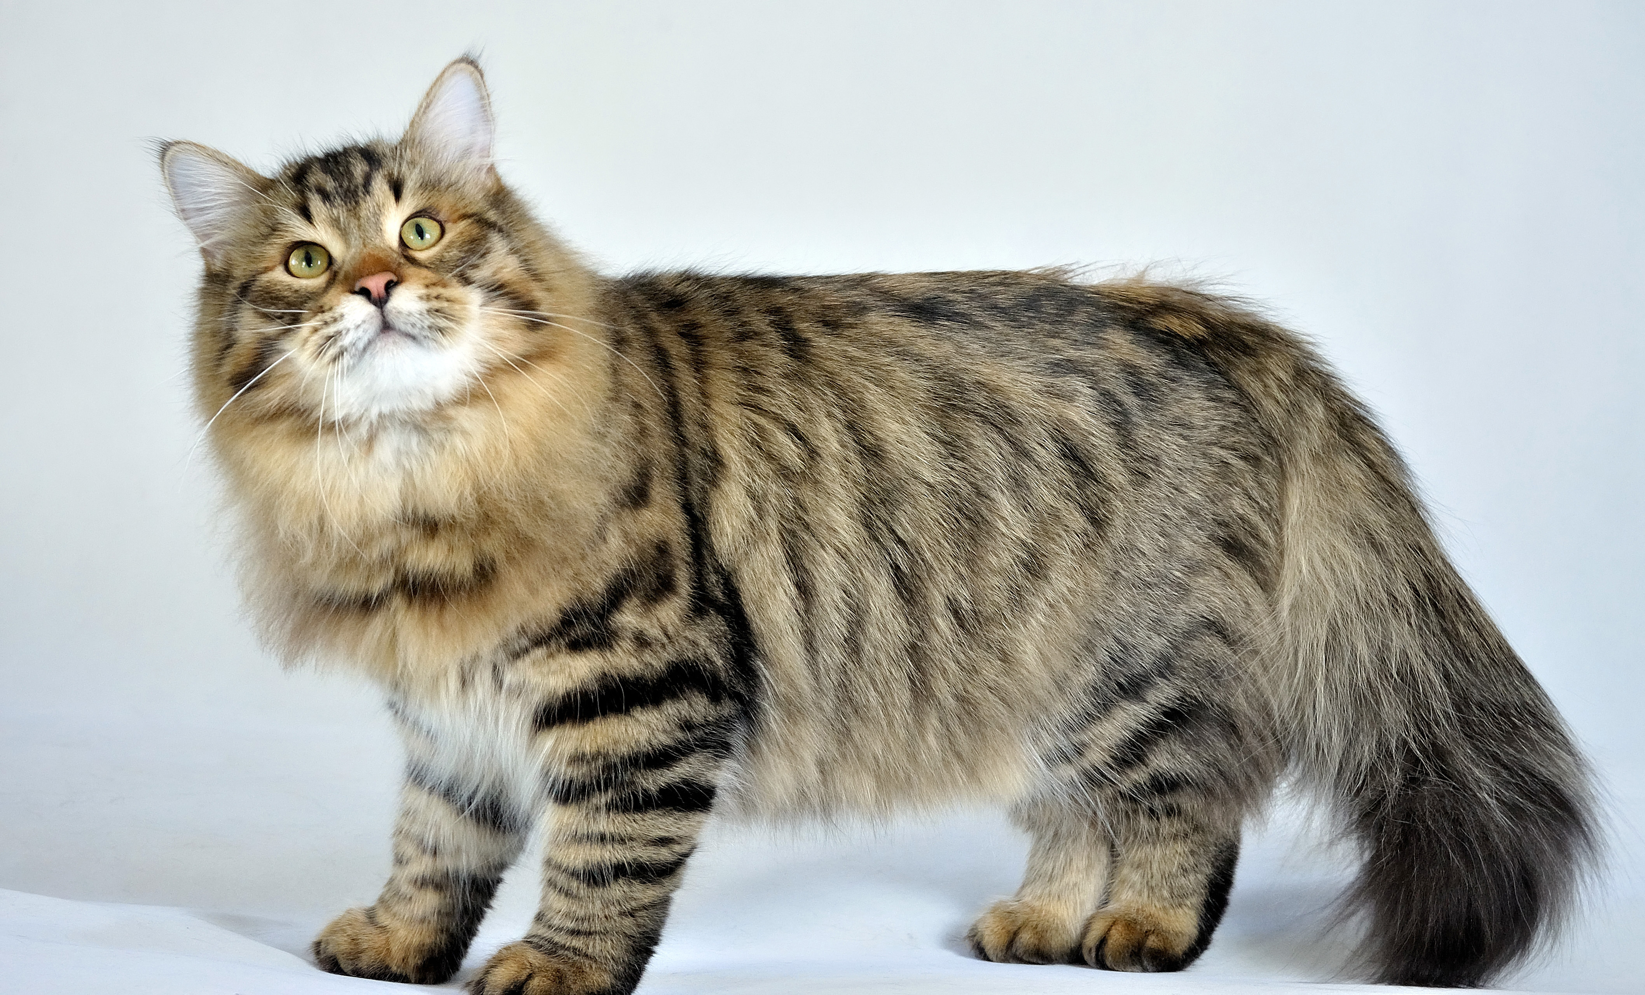
How can we classify dogs and cats?

Slide 3
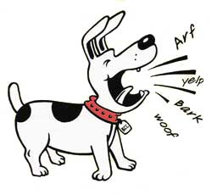

Features
Sounds
Claws

Slide 4
Claws
Who is this?
Sounds

Slide 5

How much does the price of house change?
Age | Loan | House Price Index
25 | $44,000 | 135
35 | $60,000 | 256
45 | $80,000 | 231
20 | $20,000 | 267
52 | $18,000 | 150
… | … | …
48 | $142,000 | ?

Slide 6

k-Nearest Neighbors (kNN)
An non parametric lazy machine learning algorithm
Classification and Regression
Notes:
Lazy: does not make any assumptions on the underlying data distribution.
training phase is pretty fast
all the training data is needed during the testing phase

Slide 7
Classification: Dog or Cat?

Slide 8
k-Nearest Neighbors
K=3
Claws
Who is this?
Sounds

Slide 9
kNN Algorithm in short
Measure distances
Assign K a value – preferably a small odd number
Find the closest number of K
Assign the new point from majority of the class
Notes:
This is how the K-Nearest Neighbour algorithm works. Firstly we have a variable "K". With this, you assign "K" a value from 1 to the total number of examples. The best value to chose for K is a low odd number. With this value of "K", we look at the k closest points on the graph from the location of the new example point. The next part is to assign the new point a class, the class type will be determined from the majority of the closest points.

Slide 10
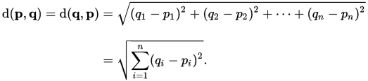
Euclidean distance

Slide 11
An example for classification
Name | Acid Durability | strength | Class
Type-1 | 7 | 7 | Bad
Type-2 | 7 | 4 | Bad
Type-3 | 3 | 4 | Good
Type-4 | 1 | 4 | Good
Test data: acid durability =3, and the strength =7, class=?

Slide 12
Similarity based on Euclidean distance
Name | Acid Durability | strength | Class | Distance
Type-1 | 7 | 7 | Bad | Sqrt((7-3)²+ (7-7)²)=4
Type-2 | 7 | 4 | Bad | 5
Type-3 | 3 | 4 | Good | 3
Type-4 | 1 | 4 | Good | 3.6
Test data: acid durability =3, and the strength =7, class=?

Slide 13
Rank
Name | Acid Durability | strength | Class | Distance | Rank
Type-1 | 7 | 7 | Bad | 4 | 3
Type-2 | 7 | 4 | Bad | 5 | 4
Type-3 | 3 | 4 | Good | 3 | 1
Type-4 | 1 | 4 | Good | 3.6 | 2
Test data: acid durability =3, and the strength =7, class=?

Slide 14
K=1
Name | Acid Durability | strength | Class | Distance | Rank
Type-1 | 7 | 7 | Bad | 4 | 3
Type-2 | 7 | 4 | Bad | 5 | 4
Type-3 | 3 | 4 | Good | 3 | 1
Type-4 | 1 | 4 | Good | 3.6 | 2
Test data: acid durability =3, and the strength =7, class=Good

Slide 15
K=2
Name | Acid Durability | strength | Class | Distance | Rank
Type-1 | 7 | 7 | Bad | 4 | 3
Type-2 | 7 | 4 | Bad | 5 | 4
Type-3 | 3 | 4 | Good | 3 | 1
Type-4 | 1 | 4 | Good | 3.6 | 2
Test data: acid durability =3, and the strength =7, class=Good

Slide 16
K=3
Name | Acid Durability | strength | Class | Distance | Rank
Type-1 | 7 | 7 | Bad | 4 | 3
Type-2 | 7 | 4 | Bad | 5 | 4
Type-3 | 3 | 4 | Good | 3 | 1
Type-4 | 1 | 4 | Good | 3.6 | 2
Test data: acid durability =3, and the strength =7, class=?
2* Good >1 Bad
Class = Good

Slide 17
An example for regression
Age | Loan | House Price Index | Distance
25 | $44,000 | 135 | 102000
35 | $60,000 | 256 | 82000
45 | $80,000 | 231 | 62000
20 | $20,000 | 267 | 122000
35 | $120,000 | 139 | 22000
52 | $18,000 | 150 | 124000
23 | $95,000 | 127 | 47000
40 | $62,000 | 216 | 80000
60 | $100,000 | 139 | 42000
48 | $220,000 | 250 | 78000
33 | $150,000 | 264 | 8000
48 | $142,000 | ? | ?

Slide 18
Rank
Age | Loan | House Price Index | Distance | Rank
25 | $44,000 | 135 | 102000 | 9
35 | $60,000 | 256 | 82000 | 8
45 | $80,000 | 231 | 62000 | 5
20 | $20,000 | 267 | 122000 | 10
35 | $120,000 | 139 | 22000 | 2
52 | $18,000 | 150 | 124000 | 11
23 | $95,000 | 127 | 47000 | 4
40 | $62,000 | 216 | 80000 | 7
60 | $100,000 | 139 | 42000 | 3
48 | $220,000 | 250 | 78000 | 6
33 | $150,000 | 264 | 8000 | 1
48 | $142,000 | ? | ?

Slide 19
K=1
Age | Loan | House Price Index (HPI) | Distance | Rank
25 | $44,000 | 135 | 102000 | 9
35 | $60,000 | 256 | 82000 | 8
45 | $80,000 | 231 | 62000 | 5
20 | $20,000 | 267 | 122000 | 10
35 | $120,000 | 139 | 22000 | 2
52 | $18,000 | 150 | 124000 | 11
23 | $95,000 | 127 | 47000 | 4
40 | $62,000 | 216 | 80000 | 7
60 | $100,000 | 139 | 42000 | 3
48 | $220,000 | 250 | 78000 | 6
33 | $150,000 | 264 | 8000 | 1
48 | $142,000 | ?
HPI = 264

Slide 20
K=3
Age | Loan | House Price Index (HPI) | Distance | Rank
25 | $44,000 | 135 | 102000 | 9
35 | $60,000 | 256 | 82000 | 8
45 | $80,000 | 231 | 62000 | 5
20 | $20,000 | 267 | 122000 | 10
35 | $120,000 | 139 | 22000 | 2
52 | $18,000 | 150 | 124000 | 11
23 | $95,000 | 127 | 47000 | 4
40 | $62,000 | 216 | 80000 | 7
60 | $100,000 | 139 | 42000 | 3
48 | $220,000 | 250 | 78000 | 6
33 | $150,000 | 264 | 8000 | 1
48 | $142,000 | ?
HPI = (264+139+139)/3=180.7

Slide 21
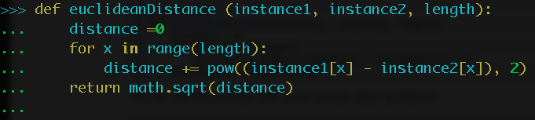
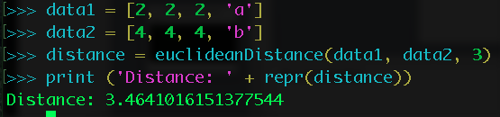
Python codes for kNN
Similarity

Slide 22
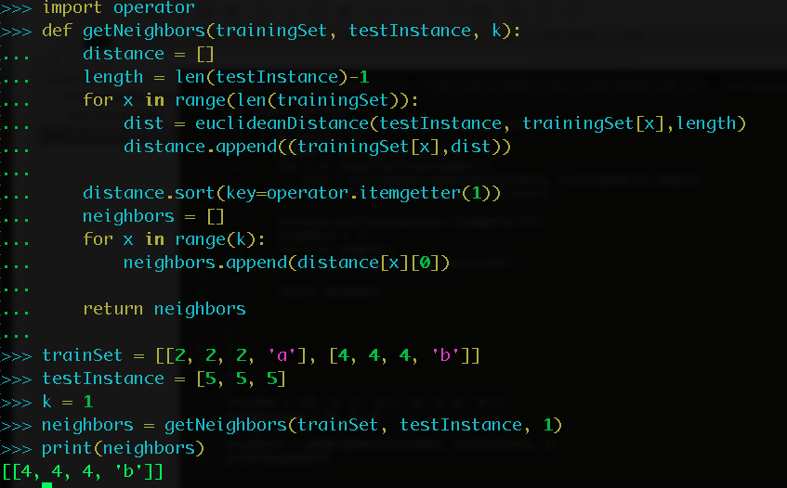
Neighbors

Slide 23
Biological Application
Gene function prediction
Gene expression clustering
Gene Ontology analyisis

Slide 24

Write python code to calculate the euclidean distance of those two yeast genes according to their expression in different time point.
Input file is can be downloaded here:
Notes:
http://machinelearningmastery.com/tutorial-to-implement-k-nearest-neighbors-in-python-from-scratch/
https://www.dataquest.io/blog/k-nearest-neighbors-in-python/
https://saravananthirumuruganathan.wordpress.com/2010/05/17/a-detailed-introduction-to-k-nearest-neighbor-knn-algorithm/
http://download.springer.com/static/pdf/711/art%253A10.1186%252F1471-2105-7-S1-S11.pdf?originUrl=http%3A%2F%2Fbmcbioinformatics.biomedcentral.com%2Farticle%2F10.1186%2F1471-2105-7-S1-S11&token2=exp=1473288681~acl=%2Fstatic%2Fpdf%2F711%2Fart%25253A10.1186%25252F1471-2105-7-S1-S11.pdf*~hmac=8bef042b2f791405e0ecb6c98dabc5046bd1287177aaa1732147f259da413daa
http://www.exploredata.net/Downloads/Gene-Expression-Data-Set

Slide 25
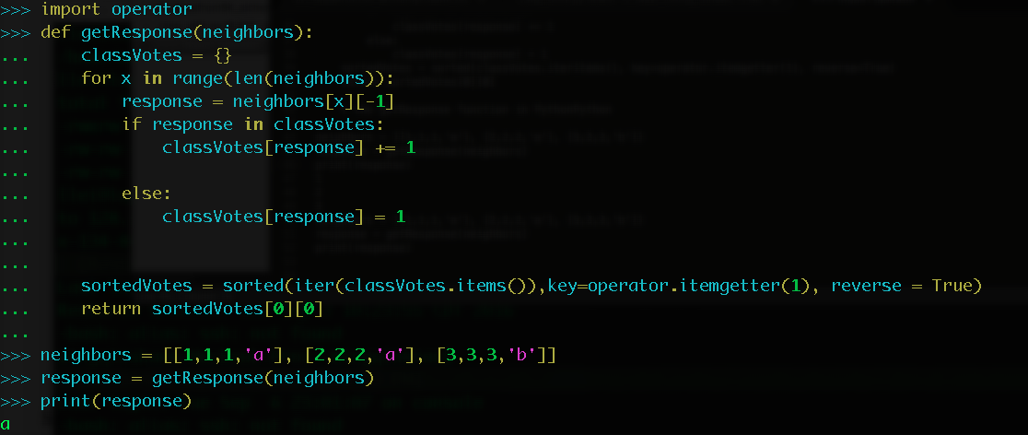
Response

